Slide 1


Welcome to Ladies Learning Code

Slide 2
Introduction to Pixlr

Slide 3
Introduction
What is Pixlr?

Slide 4
INSTRUCTOR INTRO HERE

Slide 5
Pixlr is like a free, concise version of Photoshop that is accessible to all. Like Photoshop, it is generally used for photography purposes

Slide 6
Today we’re going to attempt to touch on both. What we’re going to try to do is try to make the most of our time by covering key features like layers, filters and blend modes.
We’ll learn how to select an image against a colour background and set it against another. We’ll also learn how to integrate text and vectors.

Slide 7
Today we’re going to attempt to touch on both. What we’re going to try to do is try to make the most of our time by covering key features like layers, filters and blend modes.
We’ll learn how to select an image against a colour background and set it against another. We’ll also learn how to integrate text and vectors.

Slide 8
Interface Basics
Getting to know Photoshop

Slide 9
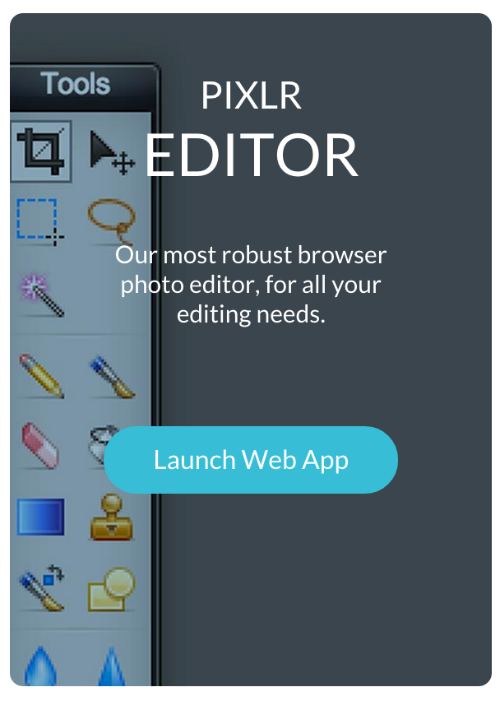
Let’s Get Started!
Open up Pixlr at http://apps.pixlr.com/editor/

Slide 10
Menu bars
Menus are probably the most familiar aspect of the Photoshop environment. In the menu bar across the top you’ll see some familiar language from other applications.

Slide 11
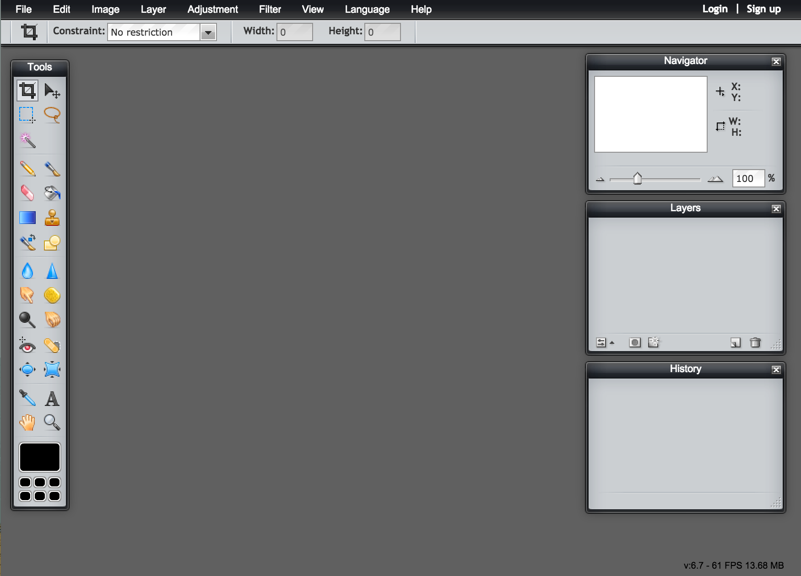
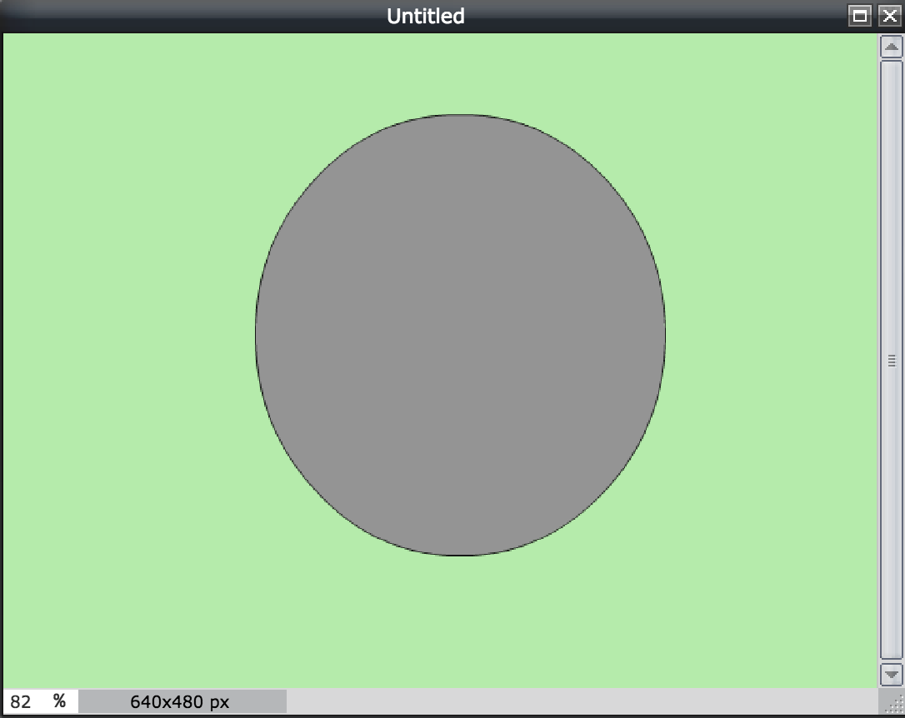
Menu bar
Toolbar
Layers
panel

Slide 12
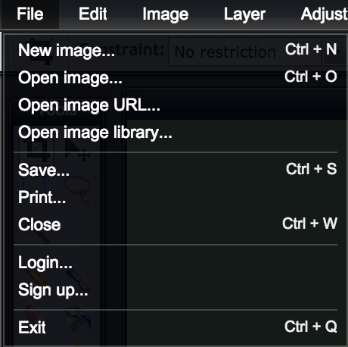
File Menu
There are 2 primary ways to
work inside Photoshop one is
to open an existing image or
file, the other is to create a new
composition from scratch for
now we’re going to open an
existing file to get to know our
way around the interface.

Slide 13
Open File
Getting-to-know-each-other.psd

Slide 14
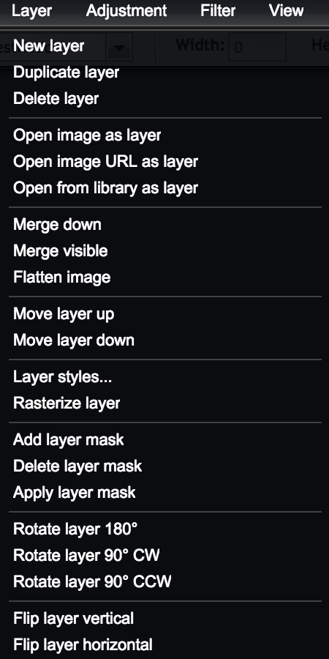
Layer menu
Contains items that affect individual layers: new layer, duplicate layer, rasterization etc.

Slide 15
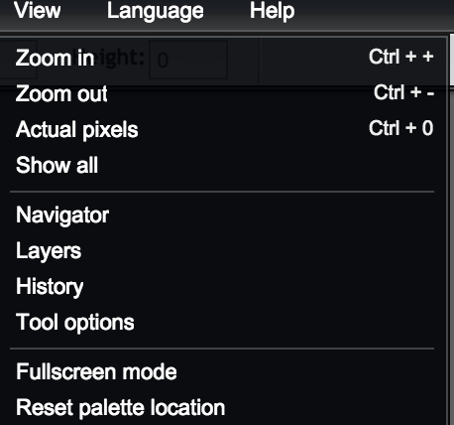
View menu
Affects the way you are viewing the document this is where you can control things like zoom
level and actual pixels, or other helpful tools like rulers and guides.

Slide 16
WINDOW MENU?
NULL

Slide 17
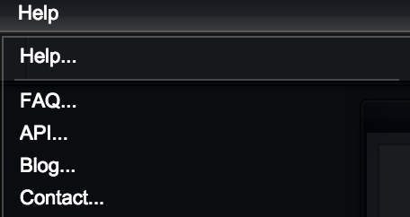
Help Menu
Helpful to use if you run into any troubles, this tab can lead you to links to solve the situation.

Slide 18
Help Menu
Helpful to use if you run into any troubles, this tab can lead you to links to solve the situation.

Slide 19
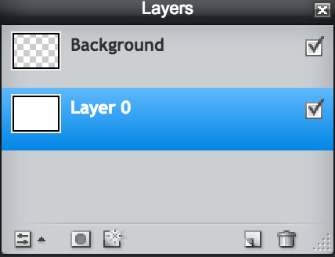
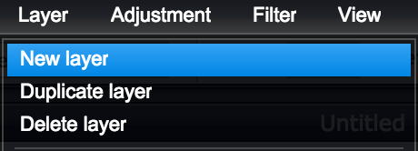
Work with layers
Make a new layer and rename it Background.

Slide 20
Work with layers
Make a new layer and rename it Background.

Slide 21
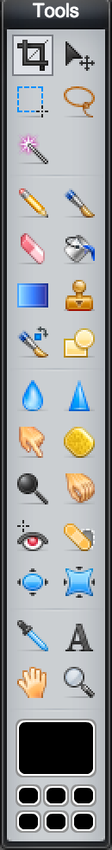
Tools
These are all the things your mouse cursor can become. Everything from a paint brush to a magic want or a plain ol’ arrow. Tools have shortcuts too!

Slide 22
Option bar
The option bar appears on the top and changes according to the tool.
Ex. crop tool

Slide 23
Layers
Everything in Photoshop (and life) is created by layering different elements on top of each other like a collage. Type, images, background colour, etc. each represent one layer. Layers are without a doubt the most important aspect of Photoshop. You can hide them, lock them, blend them, change their opacity and add effects to them.

Slide 24
Hidden layers
Everything in Photoshop (and life) is created by layering different elements on top of each other like a collage. Type, images, background colour, etc. each represent one layer. Layers are without a doubt the most important aspect of Photoshop. You can hide them, lock them, blend them, change their opacity and add effects to them.

Slide 25
NULL
SLIDES 28-30 ON ORIGINAL

Slide 26
Photo Editing
The art of putting Ryan Gosling’s head on a sea turtle

Slide 27
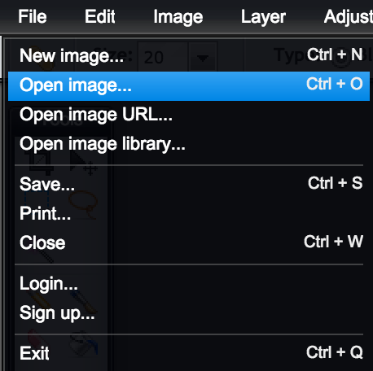
Open file

Slide 28
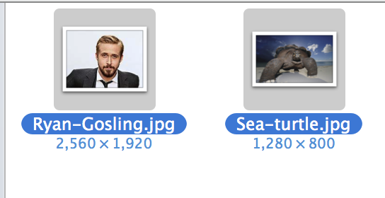
Open file

Slide 29
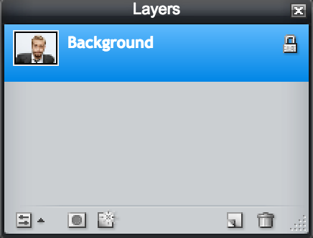
Unlock file
Double click the lock icon until a checkmark box appears. This allows the layer to be transparent.

Slide 30
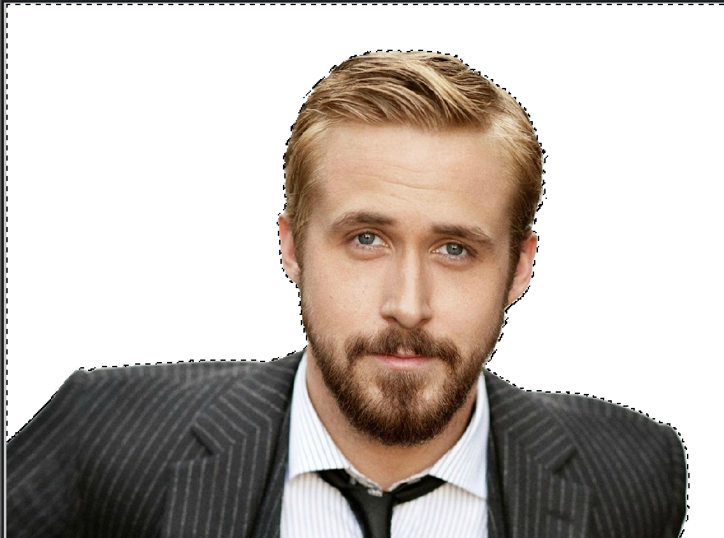

Selections
There are many ways to target specific pixels you intend to effect. The lasso and marquee tool are good for selecting polygonal shapes or when edges are not clear. Since there is a clear distinction between our subject and the background, you can just use the Magic Wand tool to cut it out.

Slide 31
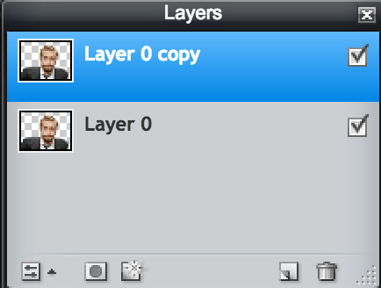
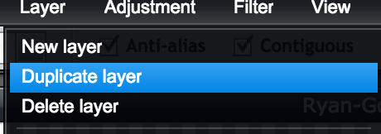
Duplicate layer
Duplicate the layer under Layer > Duplicate

Slide 32
Duplicate layer
Duplicate the layer under Layer > Duplicate

Slide 33
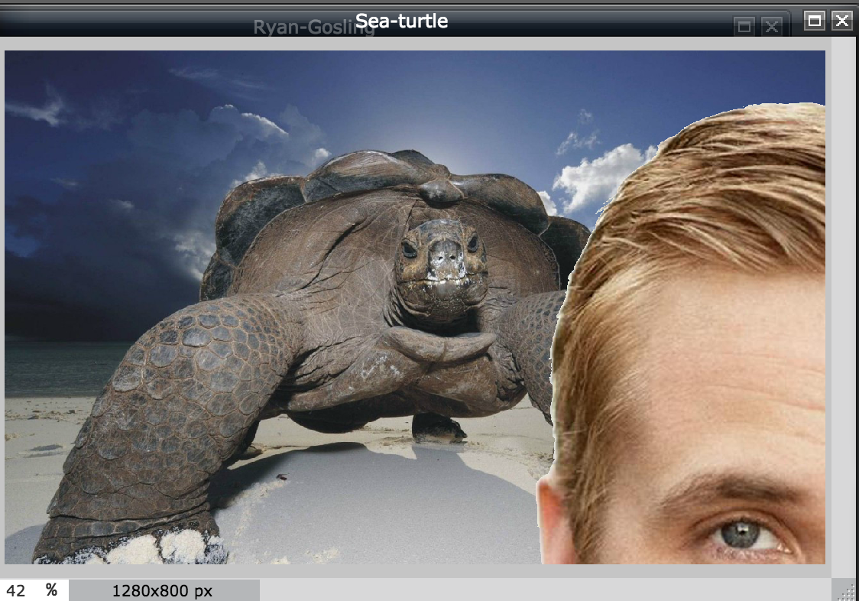
Merge!
Drag the duplicate layer to the Sea Turtle file.

Slide 34
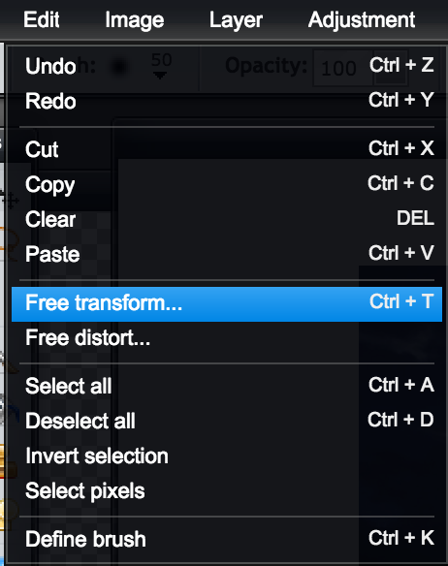
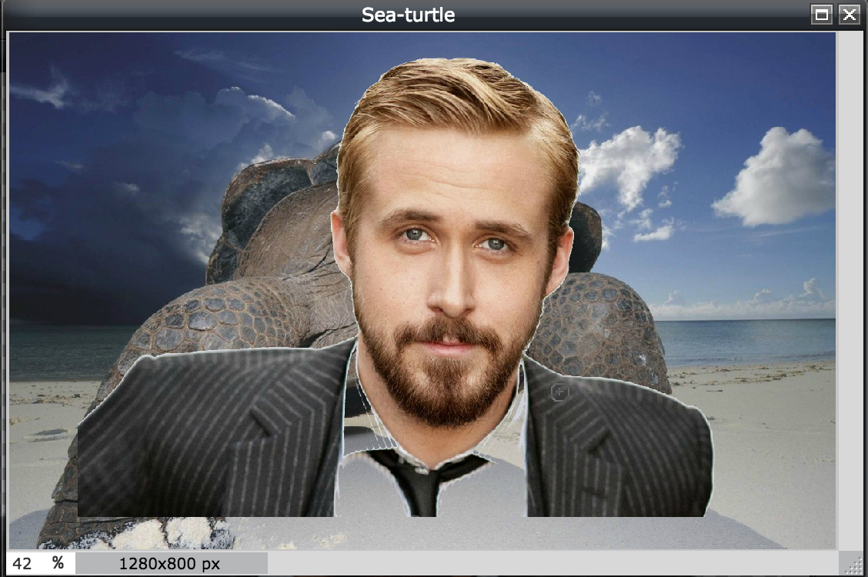
Resize
Resize Ryan Gosling using Free transform.

Slide 35
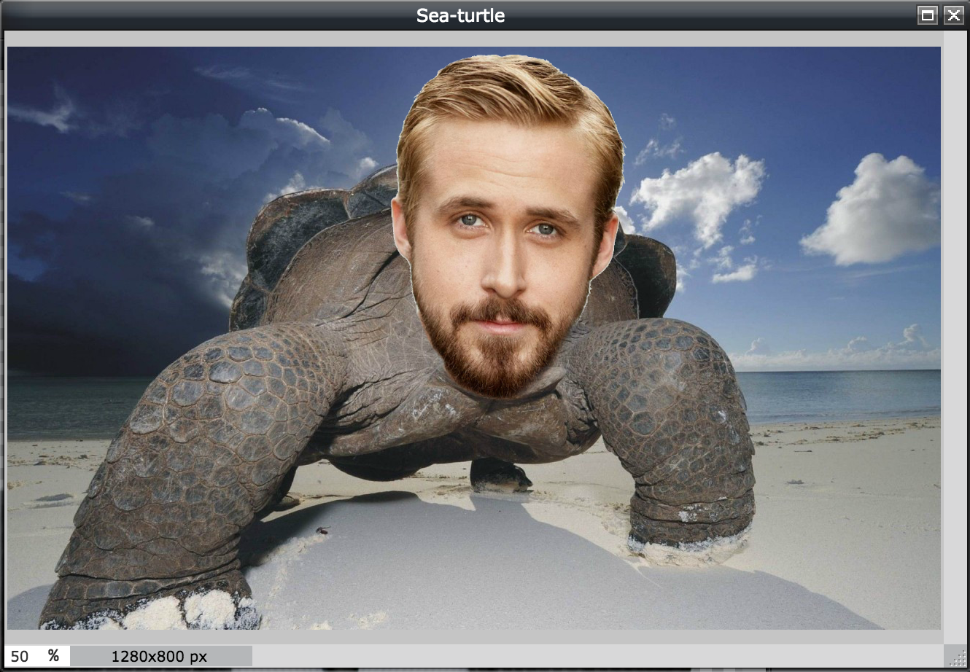

Resize
Use the Eraser tool to erase every but Ryan Gosling’s face. Feel free to change the size of the erase accordingly and if needed- zoom in!

Slide 36
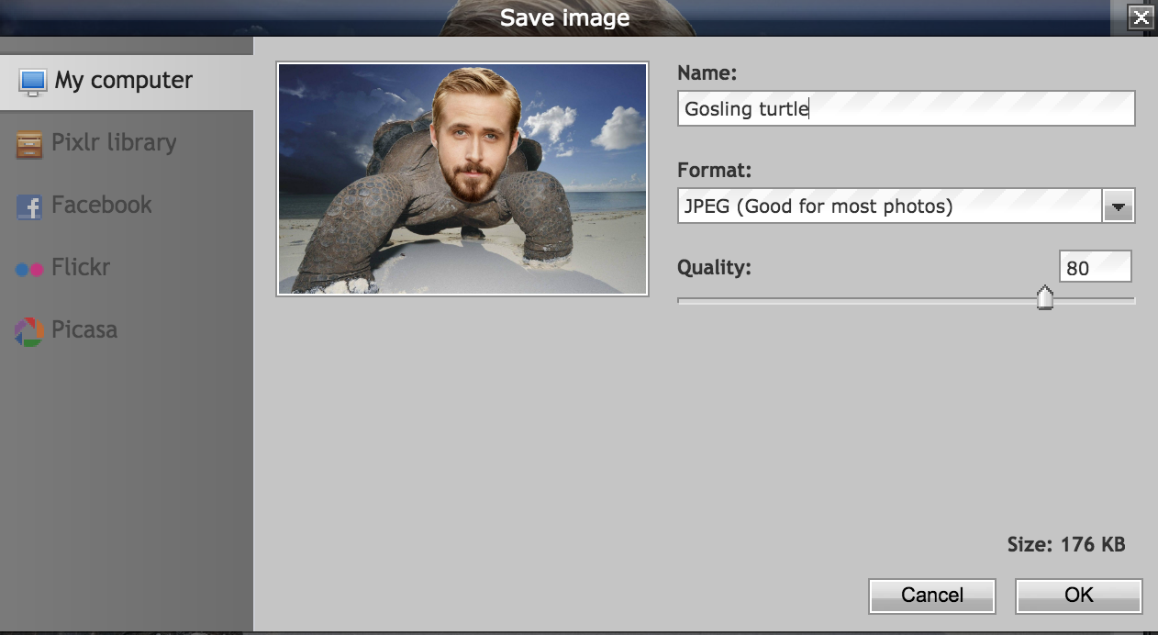
Finished!
You’re all done. Remember to save your work.

Slide 37
Personal Brand
Building elements that define ourselves

Slide 38
Personal Brand
Building elements that define ourselves

Slide 39
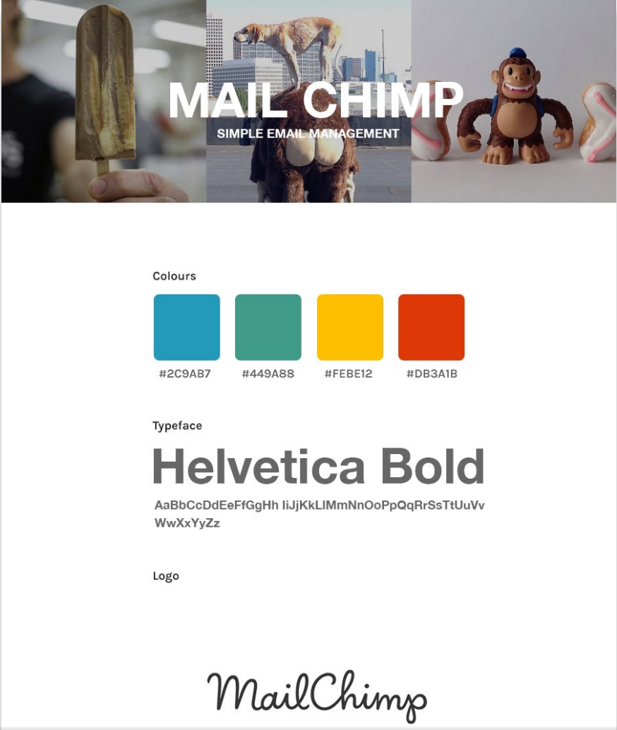

Slide 40
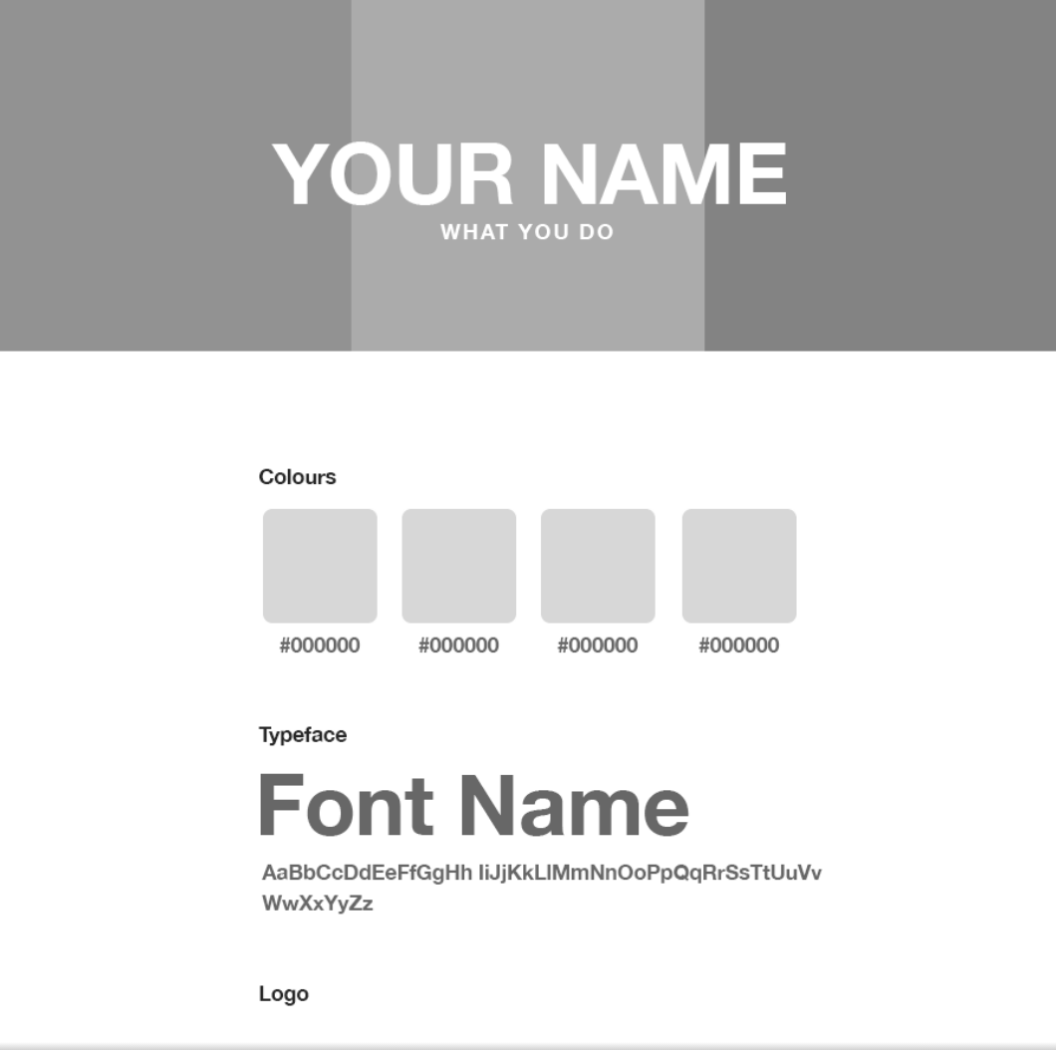
600x800
canvas

Slide 41
Header pictures
https://medium.com/@dustin/stock-photos-that-dont-suck-62ae4bcbe01b for stock images!
Crop the images to these settings:

Slide 42
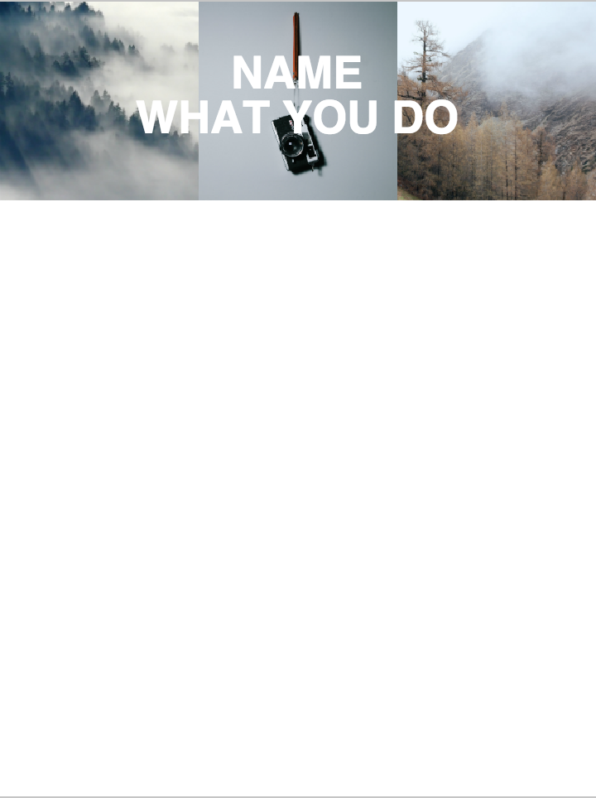
Header pictures
After cropping all your pictures, drag them side by side on the blank canvas. After, type your name and what you do over the images using the Type tool!

Slide 43
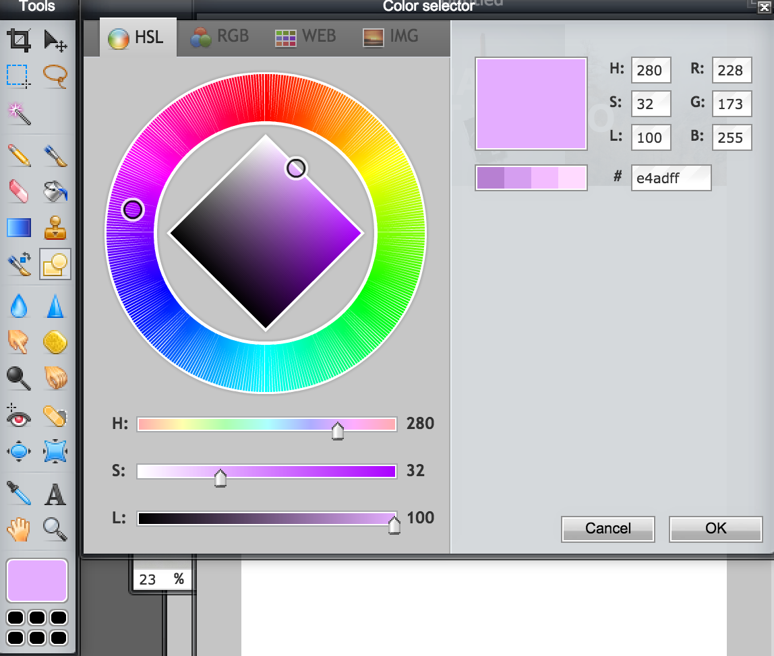

Colour palette
Go over to color.adobe.com to find a colour palette
Create a new layer (Layer > New Layer) and use the Shape tool to draw squares. Make sure to make the shapes according to the Hex codes of your colour palette on the side!

Slide 44
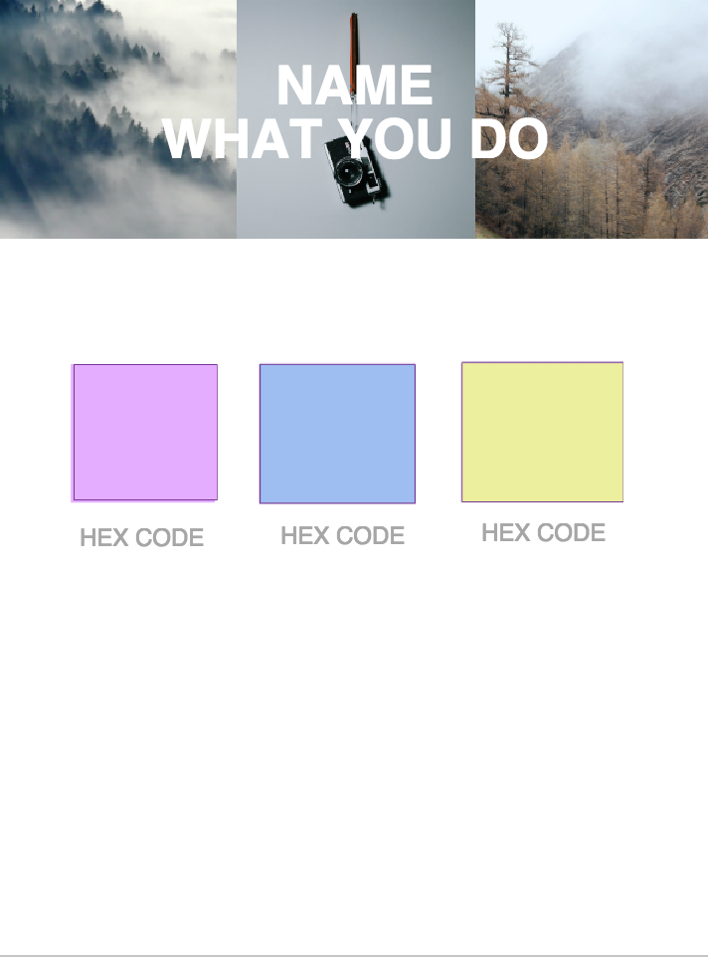

Slide 45
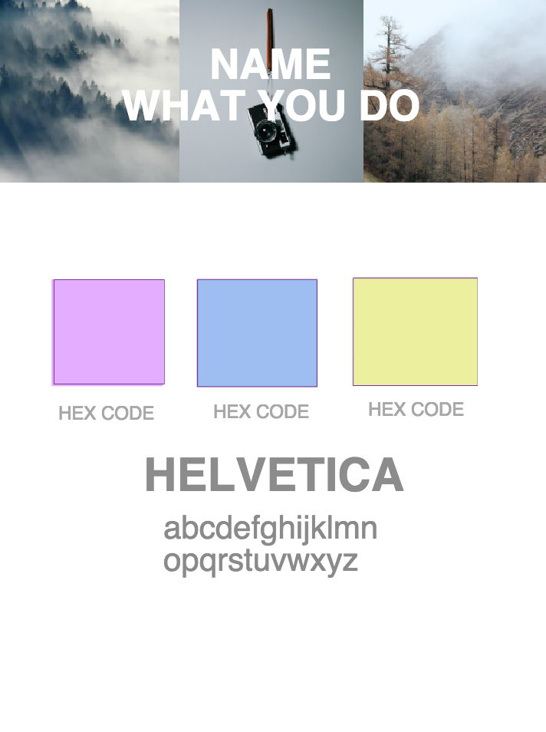
Typeface
Add a typeface!

Slide 46
Typeface
Add a typeface!

Slide 47
Logo
Making a simple and minimal logo

Slide 48
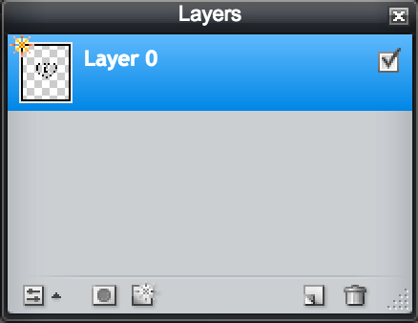
Logo making!
Go to thenounproject.com and pick out an icon
Open it on Pixlr and add click Layer Styles > Drop Shadow and change the colour accordingly!

Slide 49
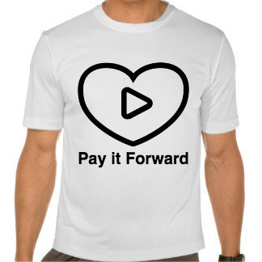
Logo making
Saving the transparent file, you can add it to anything!

Slide 50
Thank you!

